Slide 1

Predicting Default Rate for Lending Club
Rhoda Peng
Data Science Intensive Capstone Project
Thanks to Springboard mentor : Tony Peak

Slide 2
The Problems
Background: Lending Club are new financial intermediary connecting borrowers and lenders. Many loans aren’t completely paid off on time, however, and some borrowers default on the loan. That’s the problem we’ll be trying to address as we clean some data from Lending Club for machine learning.
Specific problems: What is the great factors affect loan default?
Can we predict the likelihood of a loan getting default?
Goal: Coming up with a delinquency prediction model for detecting the loans with high default rate risk. The models could help Lending Club investors make better-informed investment decisions.

Slide 3
Dataset Information
Data acquired for the period: 2018Q1
The shape of the dataset: 107,864 loans with 100 variables
There are total eight categorical variables in the dataset:
User feature (general)
User feature (financial specific): income, credit scores, credit lines
Loan general feature
Loan payment feature
Current loan payment feature
Secondary application info
Hardship
Settlement

Slide 4
What main factors might affect loan default?
User feature (general): emp_length, home_ownership
User feature(financial specific): annual_inc, dti, fico_range_low, tot_cur_bal , total_cu_tl, pub_rec, il_util, total_bal_il, revol_util
Loan general feature: loan_amnt, purpose, term, application_type
What is the Target Variable: Loan Status

Slide 5
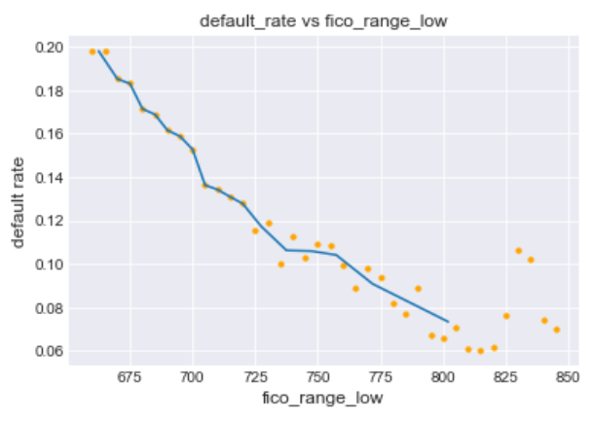
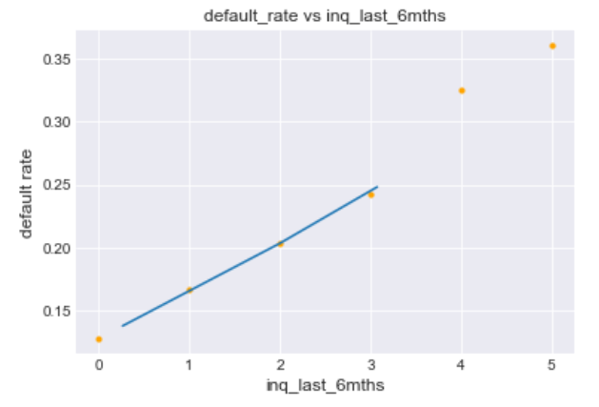
Data Exploration https://github.com/rhodapang/Lending-Club-Capstone-Project/blob/main/Notebook/2-Lending%20Club%20Exploratory%20Data%20Analysis.ipynb
Conduct univariate analysis for both of numerical variables and categorical variables
Conduct the bivariate analysis between numerical variables with default rate

Slide 6
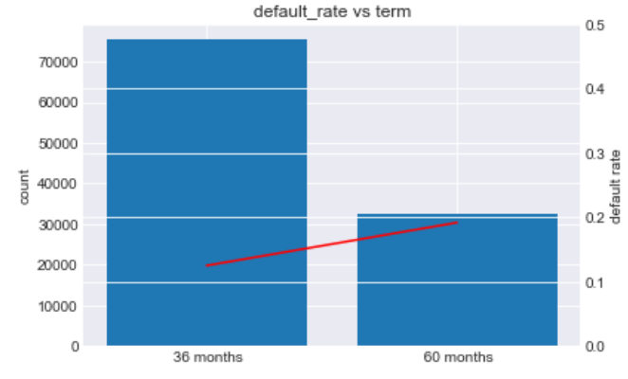
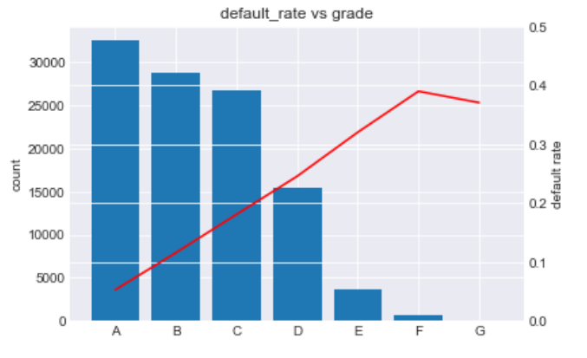
Conduct the bivariate analysis between categorical variables with default rate

Slide 7
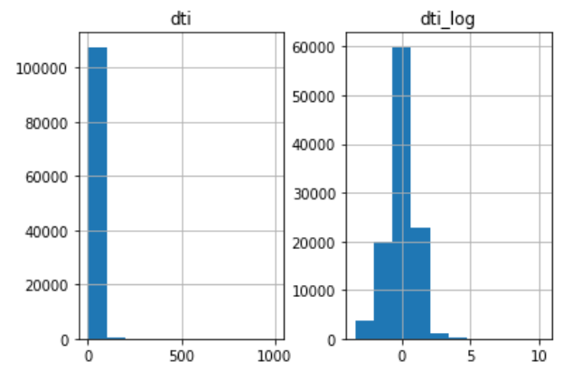
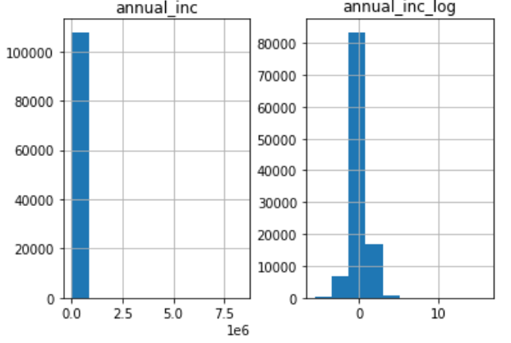
Preprocessing the dataset before modeling
Deal with the missing values
Categorical variable transformation by getting dummy
Standardize the continuous variables
Numerical variables log transformation: dti and annual_inc

Slide 8
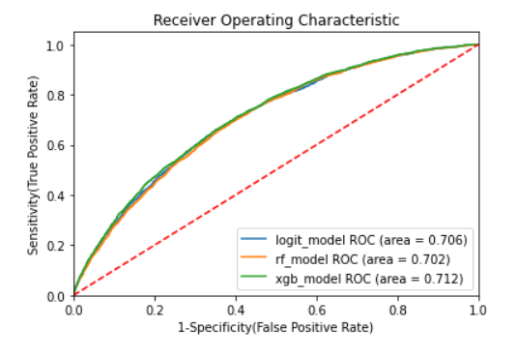
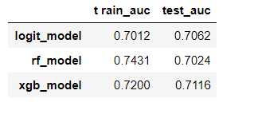
Apply Machine learning Models for predicting Default Rate
Apply for Logistic Regression Model, Random Forest Model and Xgboosting Model.

Slide 9
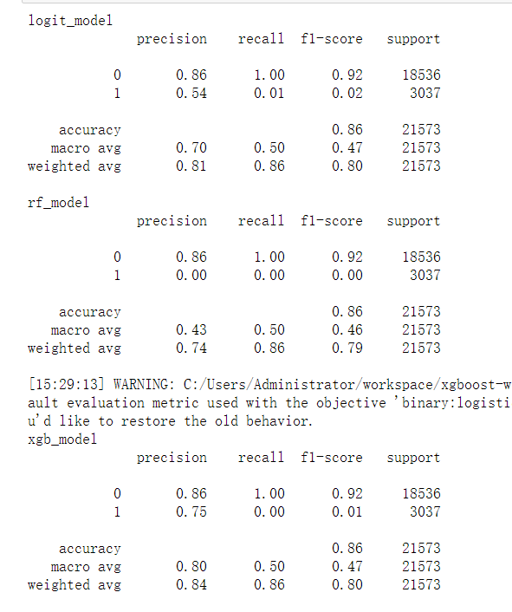
Below is the table for classification report of each model and Xgboost achieve best performance by comparison

Slide 10
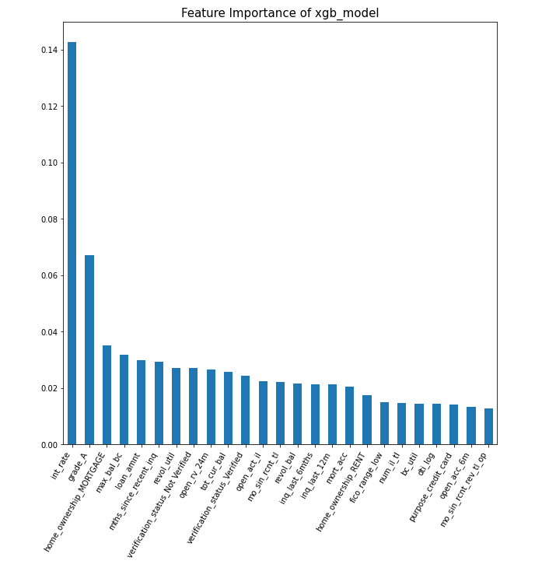
Feature Selection plot for Xgb_model

Slide 11
Conclusion
From the data provided for the classification report, we decide to adopt the Xgboosting model as the final model.
The mode feature selection, we know that the top 10 important features including int_rate, grade_A, home_ownership_mortgage, mac_bal_bc, loan_amnt, mths_since_reacent_inq, revol_util, verification_status_Not_Verified, open_rv_24m, tot_cur_bal.

